Slide 1
Fast SSP Solvers Using Short-Sighted Labeling 使用短视标记的快速随机最短路径求解器
Reporter: Hu Guodong
2019/4/8

Slide 2

Background
Shlomo Zilberstein
Professor of Computer Science, University of Massachusetts Amherst
马萨诸塞大学安姆斯特分校（麻省大学阿默斯特分校）
LAO∗: A heuristic search algorithm that finds solutions with loops
https://scholar.google.com/citations?hl=zh-CN&user=q_n7d6EAAAAJ
Luis Pineda
Source code: https://github.com/luisenp/mdp-lib/tree/vaaai17.2
https://scholar.google.com/citations?hl=zh-CN&user=rebEn8oAAAAJ&view_op=list_works&sortby=pubdate

Slide 3
Abstract
State of the art methods:
Limit problem states size
Distance : number of actions, probability etc.
FLARES:
Label states solved or not
the set of states that can be accounted for during planning is unrestricted

Slide 4
Related Work
State-space reduction besides determinization
SSiPP
Reduced problem containing states reachable at most t actions, t is a param
Reduced problem can be solved by MDP planner
Trevizan and Veloso 2014
HDP(i,j)
Heuristic Search / Dynamic Programming
i: a measure of reachability
J: a measure of re-planning
Bonet and Geffner 2003a

Slide 5
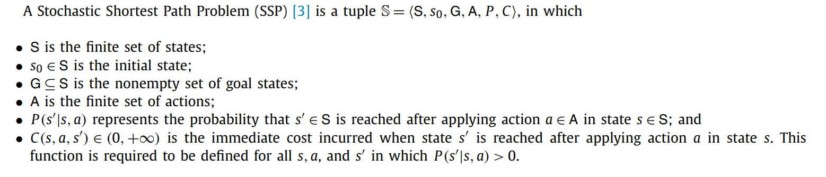



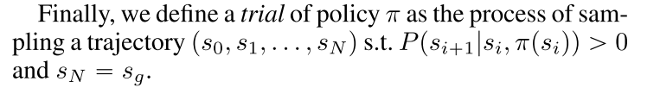
SSPs
SSP
residual error
a trial

Slide 6
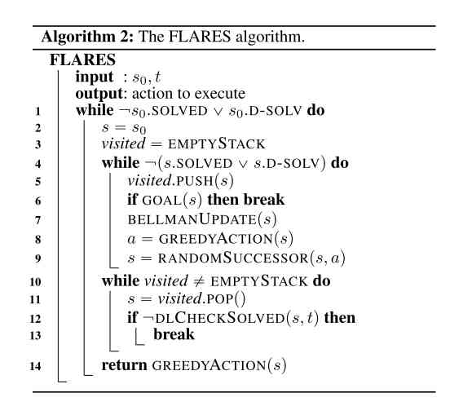
FLARES

Slide 7
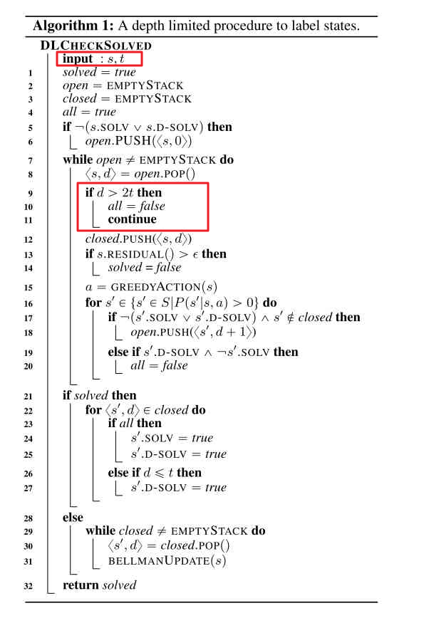
DL Check Solved

Slide 8
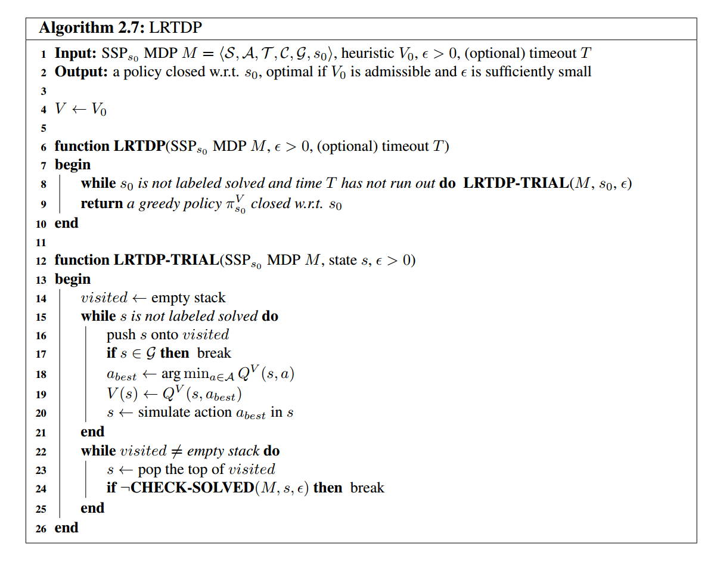
LRTDP

Slide 9
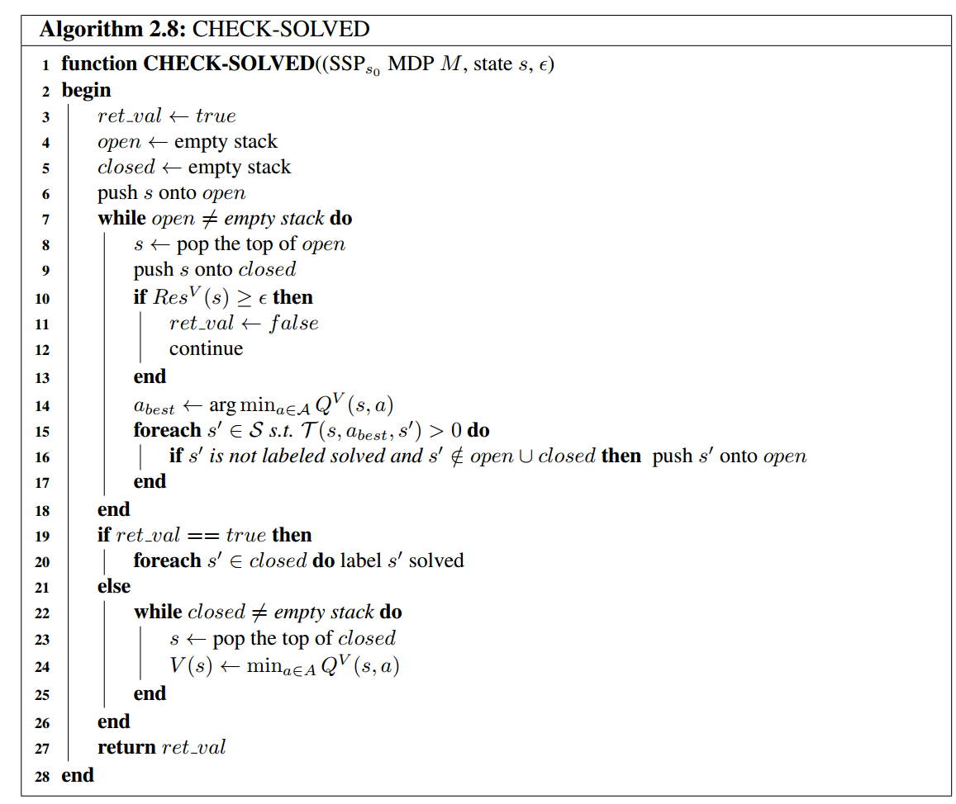
LRTDP Check solved

Slide 10
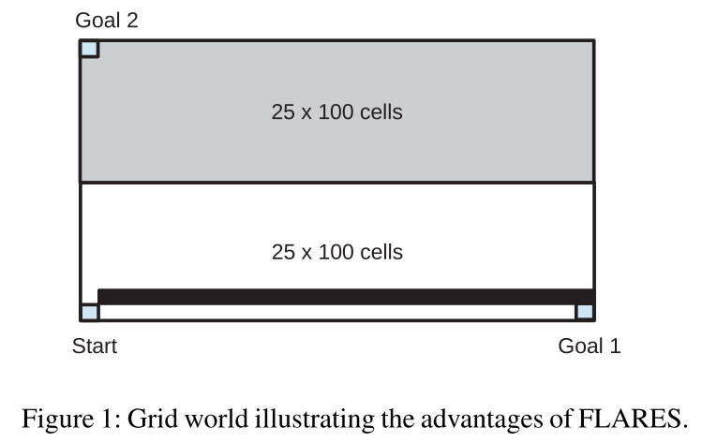
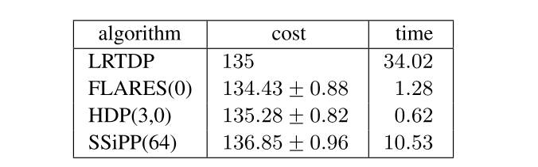
Experiments
A simple grid world problem

Slide 11
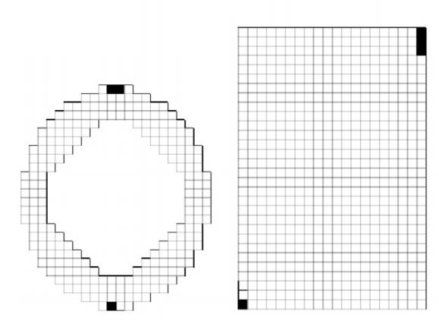
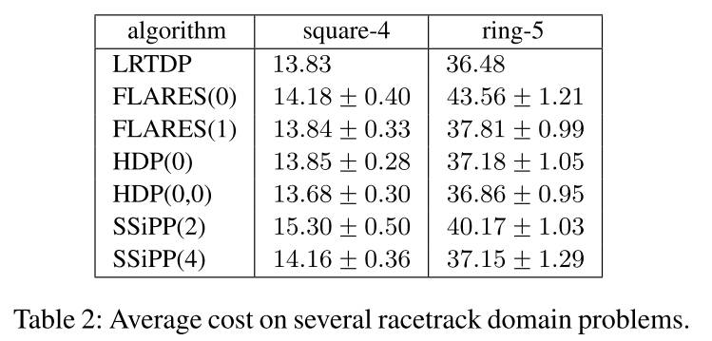
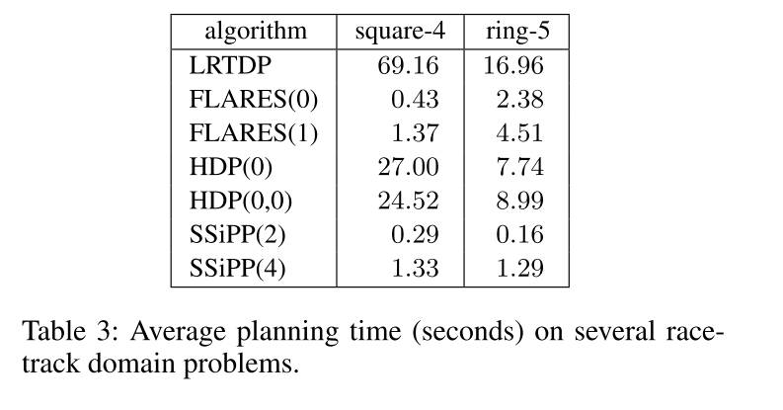
Experiments
Racetrack domain

Slide 12
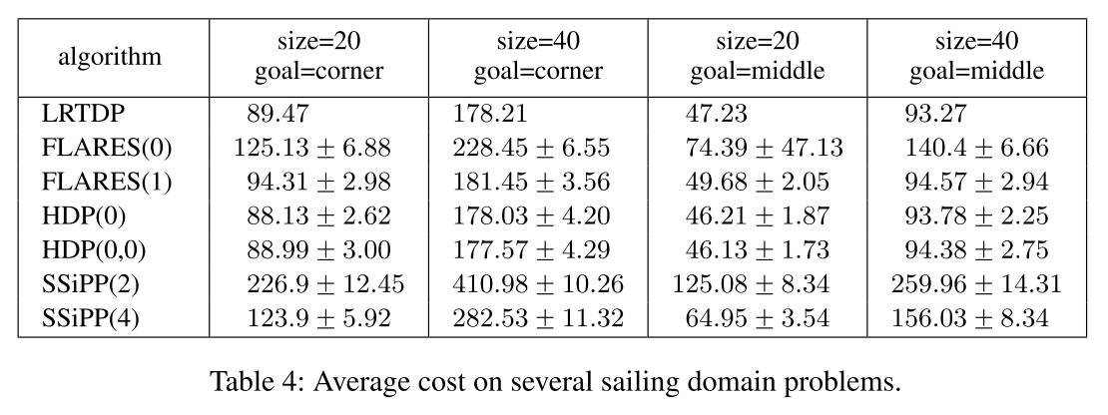
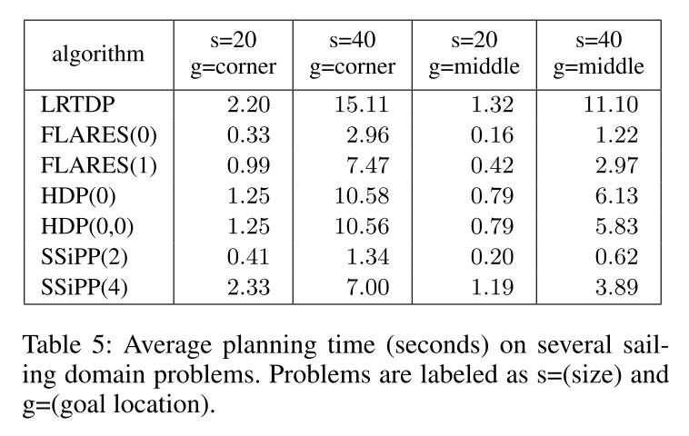
Experiments
Sailing domain

Slide 13
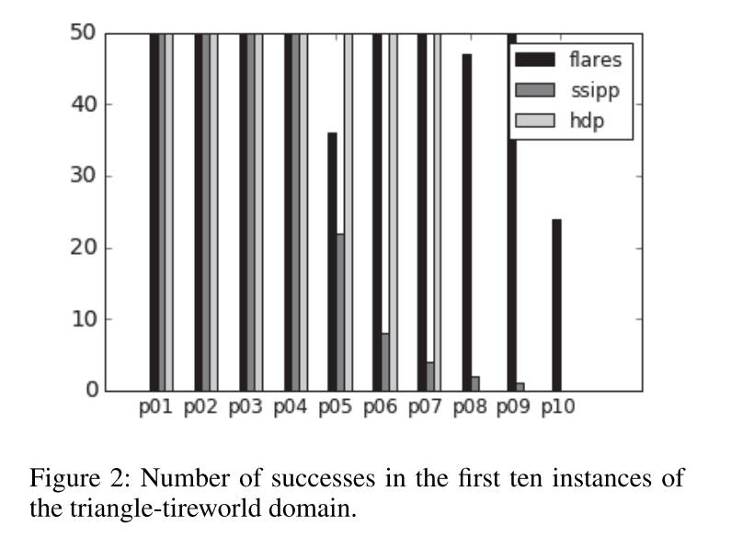
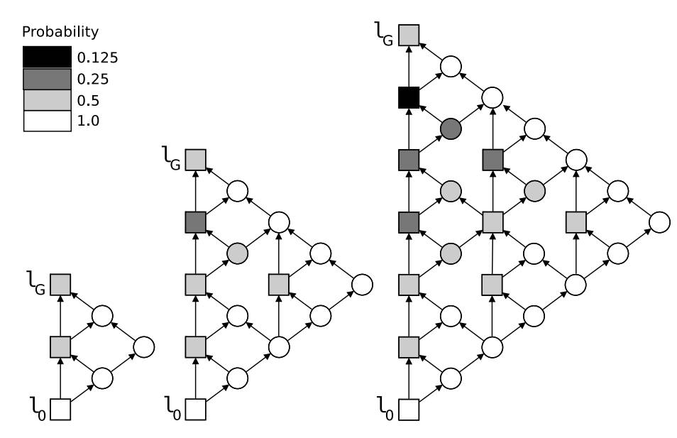
Experiments
Triangle-tireworld domain

Slide 14
Thanks!

